Slide 1
CHAPTER 2 FORCE SYSTEMS
CHAPTER OUTLINE
2/1 Introduction
2/2 Force
SECTION A Two-Dimensional Force Systems
2/3 Rectangular Components
2/4 Moment
2/5 Couple
2/6 Resultants
SECTION B Three-Dimensional Force Systems
2/7 Rectangular Components
2/8 Moment and Couple
2/9 Resultants
Anze Bizjan/Shutterstock

Slide 2
Article 2/1 Introduction
Chapter Purpose
Importance of Chapter 2 Concepts

Slide 3
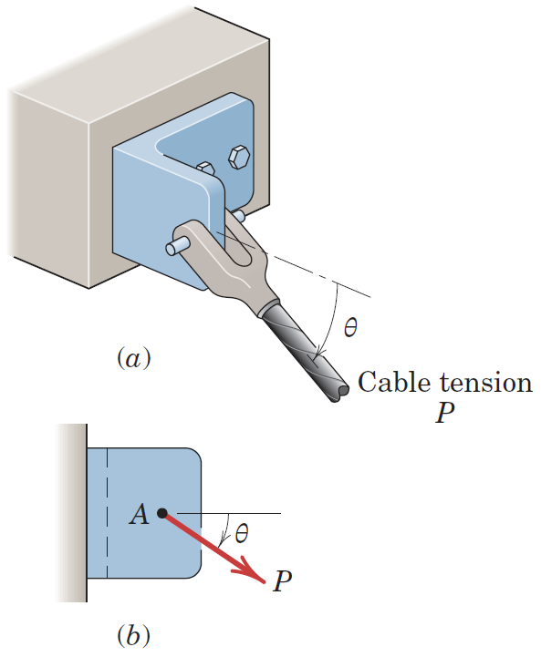
Article 2/2 Force
A Reminder and Illustration
Vector Quantity
External and Internal Effects

Slide 4
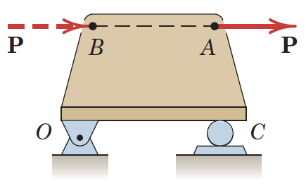
Article 2/2 – Principle of Transmissibility
Statement of the Principle
A force may be applied at any point on its given line of action without altering the resultant effects of the force external to the rigid body on which it acts.
Illustration
Sliding Vectors

Slide 5
Article 2/2 – Force Classification
Contact Force
Body Force
Concentrated Force
Distributed Force
Action and Reaction Pairs

Slide 6
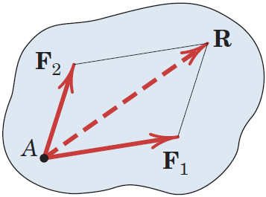
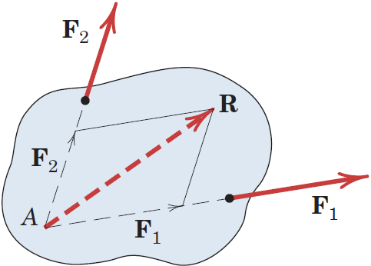
Article 2/2 – Concurrent Forces (1 of 2)
Definition and Vector Sum
Application of Transmissibility

Slide 7
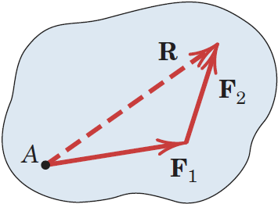
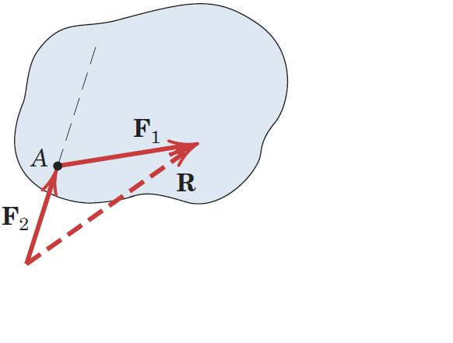
Article 2/2 – Concurrent Forces (2 of 2)
Parallelogram Law of Vector Addition
Order of Addition

Slide 8
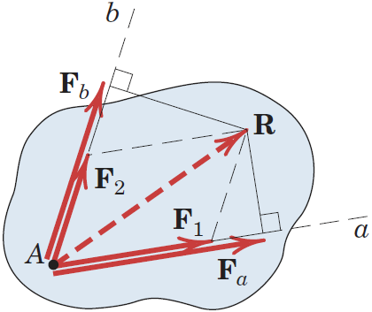
Article 2/2 – Vector Components
Vector Components: F₁ and F₂
Obey the Parallelogram Law of Addition
Directed along the Axes of Choice
Vector Projections: F_{a} and F_{b}
Do not obey the Parallelogram Law of Addition
Directed along the Axes of Choice

Slide 9
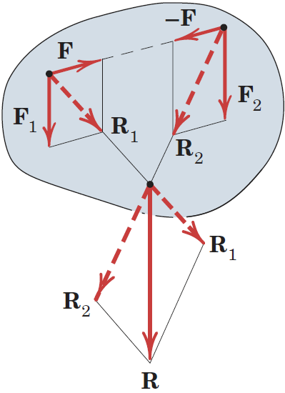
Article 2/2 – Special Case of Vector Addition
Parallel Vectors: F₁ and F₂
Procedure
Add Equal, Opposite, Collinear Forces F and -F
Find the Resultants R₁ and R₂
Locate the Point of Concurrency for the Resultants
Add the Resultants at the Point of Concurrency

Slide 10
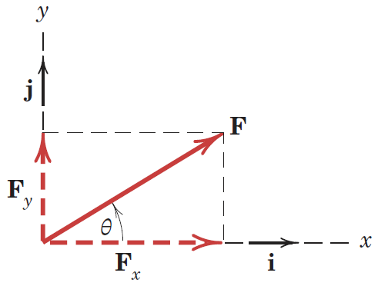
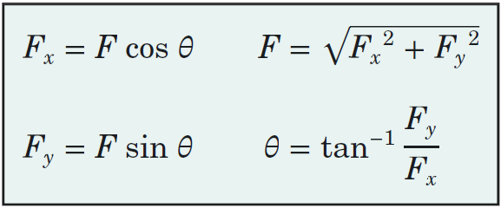
2/3 Rectangular Components
Illustration
Vector Components: F = F_{x} + F_{y}
Scalar Components: F = F_{x}i + F_{y}j
Other Useful Relationships

Slide 11
2/3 Conventions for Describing Vector Components
Vector Magnitude, F
Lightface, Italic Font
Always Positive
Scalar Component, F_{x}
Lightface, Italic Font
Positive or Negative
Force Vector Depiction
Solid, Red Arrow
Component Vector Depiction
Dashed, Red Arrow

Slide 12
2/3 Determining the Components of a Force (1 of 2)
It is often the case that…
Dimensions or axes are not given in horizontal and vertical directions.
Angles are not measured counterclockwise from the x-axis.
Coordinates do not originate from the line of action of a force.
We still need to be able to find the components of a force vector!

Slide 13
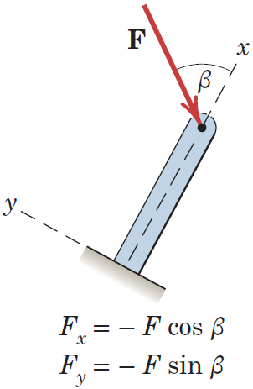
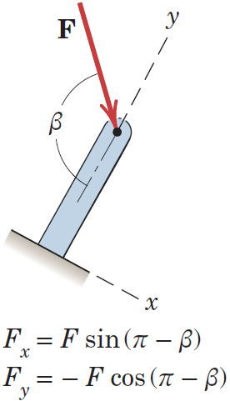
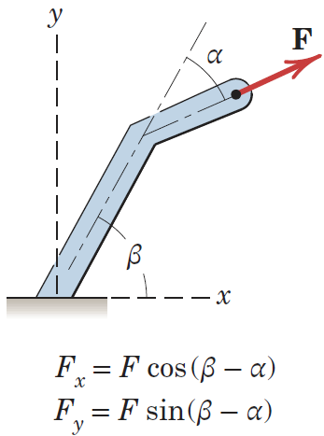
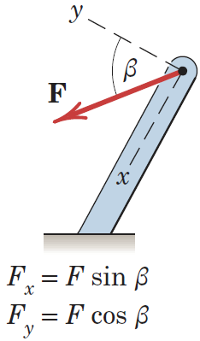
2/3 Determining the Components of a Force (2 of 2)
Some Illustrations

Slide 14
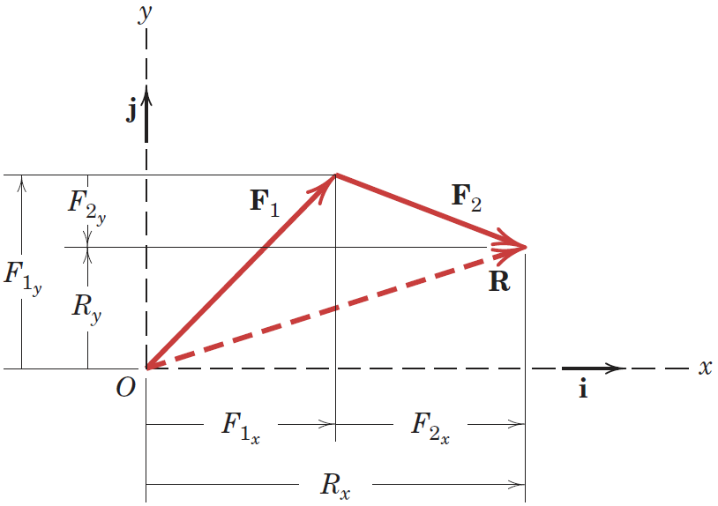
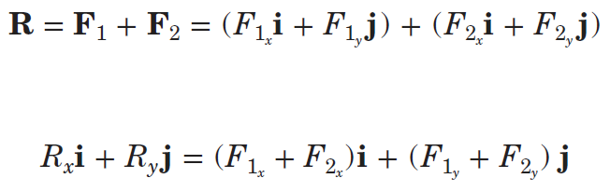
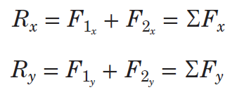
2/3 Finding Resultants using Components
Illustration
Mathematics

Slide 15
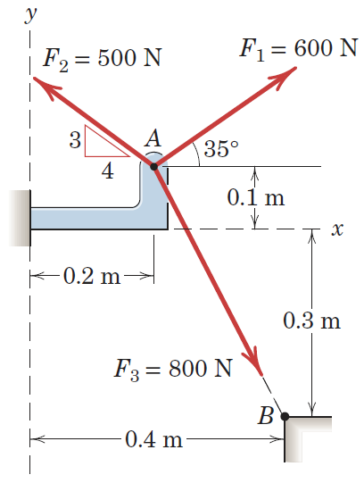
Article 2/3 – Sample Problem 2/1 (1 of 3)
Problem Statement
The forces F₁, F₂, and F₃, all of which act on point A of the bracket, are specified in three different ways. Determine the x and y scalar components of each of the three forces.

Slide 16
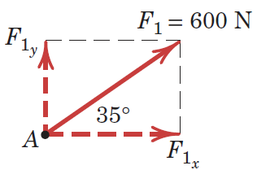
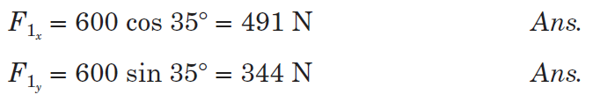
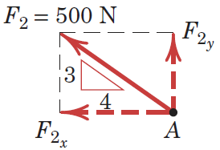
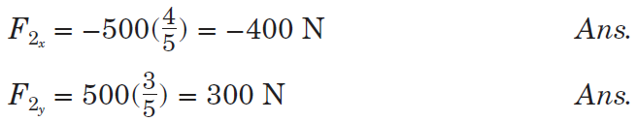
Article 2/3 – Sample Problem 2/1 (2 of 3)
Scalar Components of F₁
Scalar Components of F₂

Slide 17
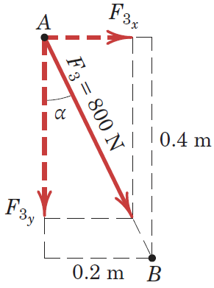
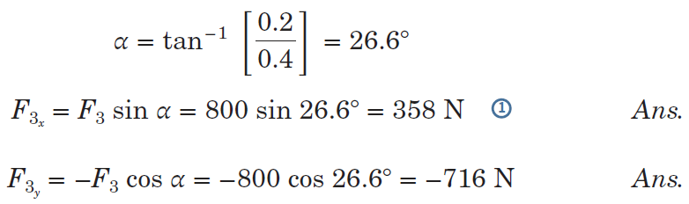
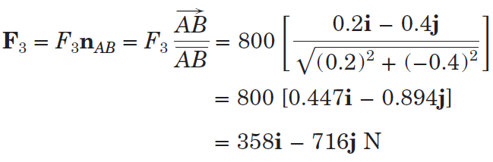
Article 2/3 – Sample Problem 2/1 (3 of 3)
Scalar Components of F₃
Alternative Calculation

Slide 18
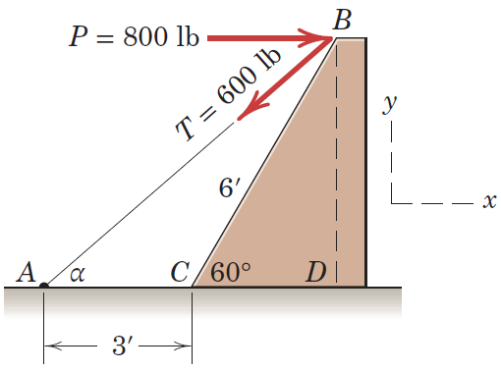
Article 2/3 – Sample Problem 2/2 (1 of 4)
Problem Statement
Combine the two forces P and T, which act on the fixed structure at B, into a single equivalent force R.

Slide 19
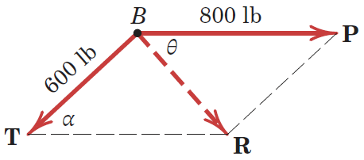
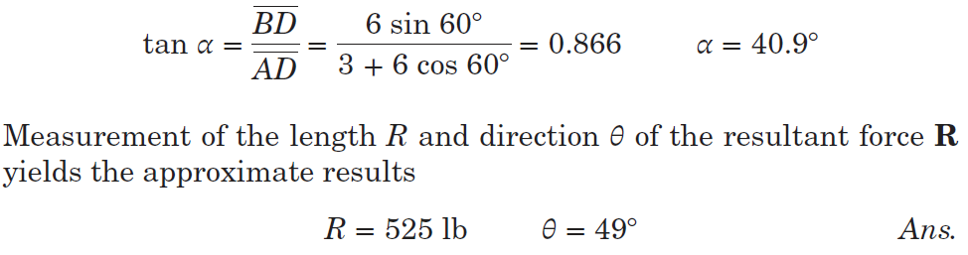
Article 2/3 – Sample Problem 2/2 (2 of 4)
Graphical Solution (Scaled Drawing)

Slide 20
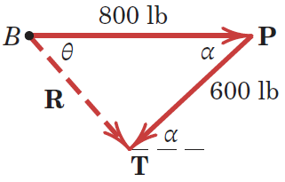
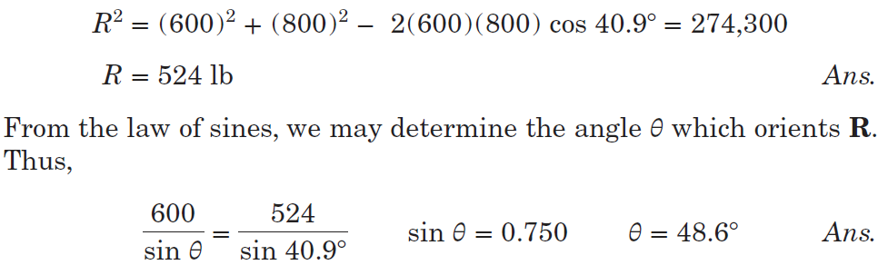
Article 2/3 – Sample Problem 2/2 (3 of 4)
Geometric Solution

Slide 21

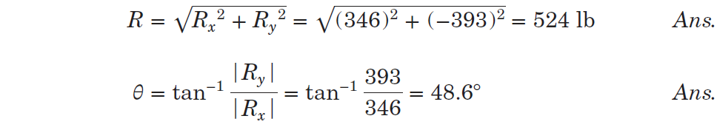
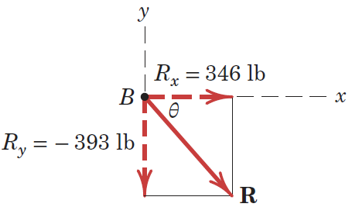
Article 2/3 – Sample Problem 2/2 (4 of 4)
Algebraic Solution
Vector Representation

Slide 22
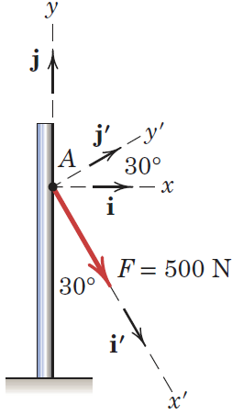
Article 2/3 – Sample Problem 2/3 (1 of 3)
Problem Statement
The 500-N force F is applied to the vertical pole as shown. (1) Write F in terms of the unit vectors i and j and identify both its vector and scalar components. (2) Determine the scalar components of the force vector F along the x′- and y′-axes. (3) Determine the scalar components of F along the x- and y′-axes.

Slide 23
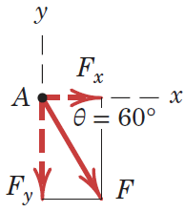
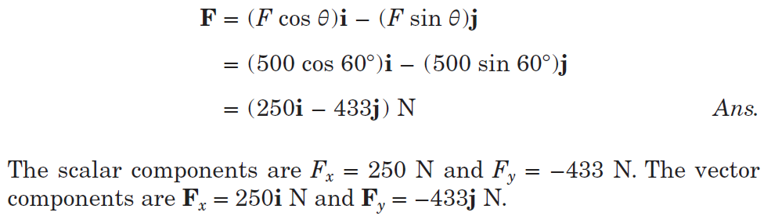
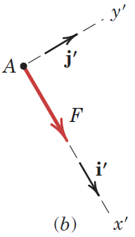
Article 2/3 – Sample Problem 2/3 (2 of 3)
Part 1 Solution
Part 2 Solution

Slide 24
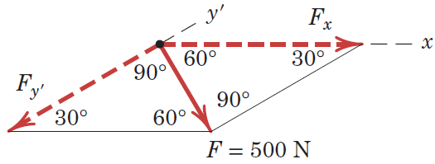
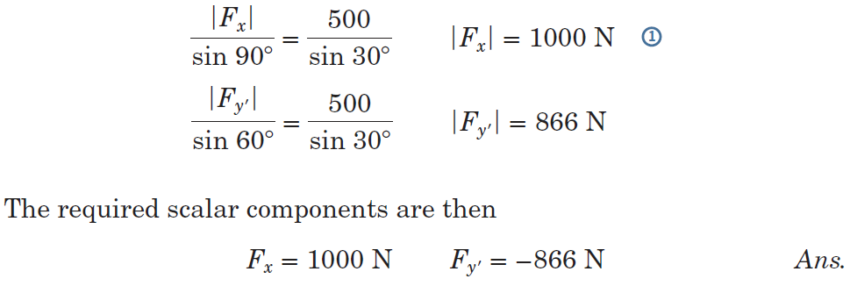
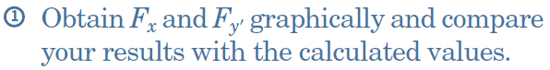
Article 2/3 – Sample Problem 2/3 (3 of 3)
Part 3 Solution

Slide 25
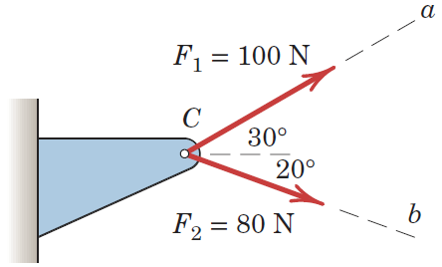
Article 2/3 – Sample Problem 2/4 (1 of 2)
Problem Statement
Forces F₁ and F₂ act on the bracket as shown. Determine the projection F_{b} of their resultant R onto the b-axis.

Slide 26
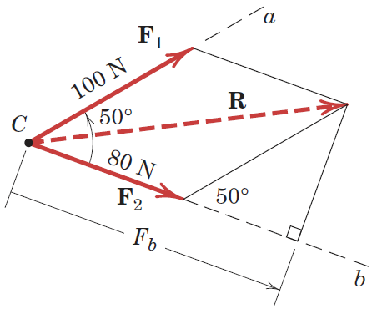
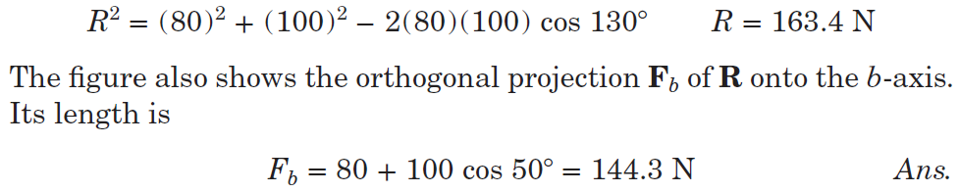
Article 2/3 – Sample Problem 2/4 (1 of 2)
Solution

Slide 27
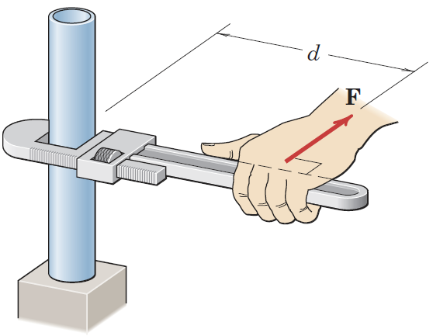
Article 2/4 Moment
A moment is the tendency of a force to rotate a body about an axis.
Illustration: Pipe Wrench
Things to Note
Direction and Orientation of the Force
Axis of Rotation
Direction of Rotation
Effective Length, d

Slide 28
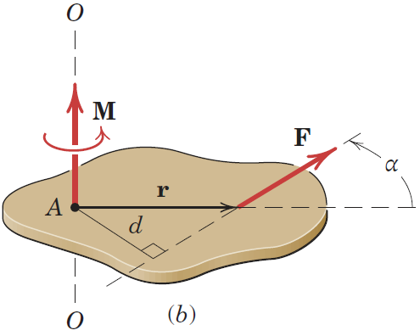
Article 2/4 – Moment about a Point (1 of 3)
Scalar Development
Moment Arm, d
Moment Vector, M
Axis of Rotation, O-O
Moment Magnitude, M = Fd
Direction of Rotation
Units

Slide 29
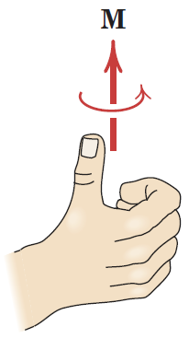
Article 2/4 – Moment about a Point (2 of 3)
The Right-Hand Rule
Position your right hand such that your fingers point in the same direction as the force.
Orient your hand such that the point you are computing the moment about is on the same side as your palm. From the figure at right, your hand is positioned such that the moment arm d intersects the middle of your palm.
Close your fingers to make a fist and extend your thumb straight up. From the figure at right, imagine closing your fist around line O-O, and your thumb would point in the direction of the moment vector. Curling your fingers about this line would represent the rotation of the moment about the axis.

Slide 30
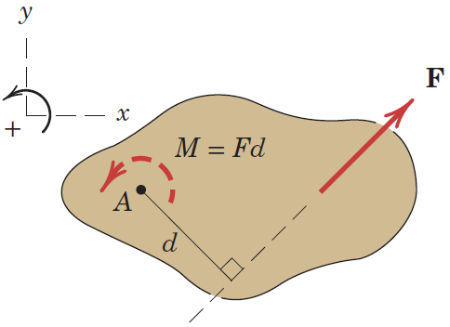
Article 2/4 – Moment about a Point (3 of 3)
Planar View
Sign Conventions
Counterclockwise, CCW
Clockwise, CW
User-Defined
Two-Dimensional Representation

Slide 31
Article 2/4 – The Cross Product
Vector Expression for Moments
Position Vector, r
Moment Vector, M = r × F
Advantages of the Cross Product
Disadvantages of the Cross Product

Slide 32
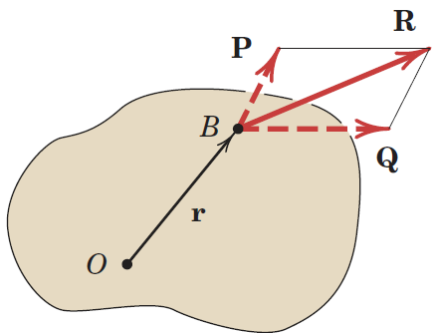
Article 2/4 – Varignon’s Theorem (1 of 2)
The Theorem Stated
The moment of a force about any point is equal to the sum of the moments of the components of the force about the same point.
The Theorem Illustrated – Vectors
R = P + Q
M_{O} = r × R = r × (P + Q) = r × P + r × Q

Slide 33
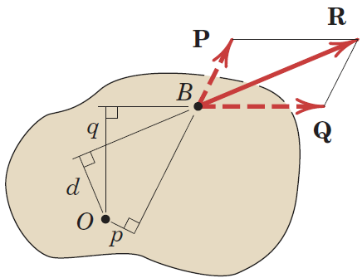
Article 2/4 – Varignon’s Theorem (1 of 2)
The Theorem Illustrated – Scalars
M_{O} = Rd = -pP + qQ (Assumes CW +)

Slide 34
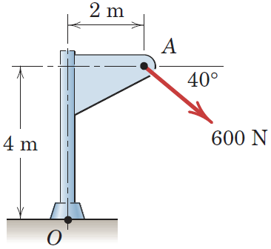
Article 2/4 – Sample Problem 2/5 (1 of 5)
Problem Statement
Calculate the magnitude of the moment about the base point O of the 600-N force in five different ways.

Slide 35
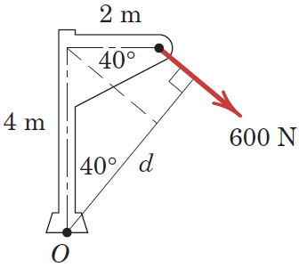


Article 2/4 – Sample Problem 2/5 (2 of 5)
Method 1: Use the Moment Arm (CW is +)

Slide 36



Article 2/4 – Sample Problem 2/5 (3 of 5)
Method 2: Use Components at A (CW is +)

Slide 37


Article 2/4 – Sample Problem 2/5 (4 of 5)
Methods 3 and 4: Alternative Moment Arms

Slide 38


Article 2/4 – Sample Problem 2/5 (5 of 5)
Method 5: Vector Approach

Slide 39

Article 2/4 – Sample Problem 2/6 (1 of 4)
Problem Statement
The trap door OA is raised by the cable AB, which passes over the small frictionless guide pulleys at B. The tension everywhere in the cable is T, and this tension applied at A causes a moment M_{O} about the hinge at O. Plot the quantity M_{O} ∕ T as a function of the door elevation angle 𝜃 over the range 0 ≤ 𝜃 ≤ 90° and note minimum and maximum values. What is the physical significance of this ratio?

Slide 40



Article 2/4 – Sample Problem 2/6 (2 of 4)
Tension Vector

Slide 41


Article 2/4 – Sample Problem 2/6 (3 of 4)
Moment Vector

Slide 42


Article 2/4 – Sample Problem 2/6 (4 of 4)
Desired Expression and Plot

Slide 43

Article 2/5 Couple
Definition
The moment produced by two equal, opposite, and noncollinear forces is called a couple.
Illustration and Derivation (Scalars)
M_{O} = F(a + d) - Fa = Fd
Irrelevance of the Moment Center O

Slide 44


Article 2/5 – Vector Algebra Method
Illustration and Derivation (Vectors)
M_{O} = r_{A} × F + r_{B} × (-F) = (r_{A} - r_{B}) × F = r × F
The Couple is a Free Vector

Slide 45

Article 2/5 – Alternative Representations of Couples
Two-Dimensional Representations

Slide 46

Article 2/5 – Equivalent Couples
Illustration

Slide 47

Article 2/5 – Force-Couple Systems (1 of 2)
Principle of the Force-Couple System
Any force which acts at a particular location on a body can be replaced by an equivalent force which acts at a different location and a couple.
Illustration of the Process

Slide 48
Article 2/5 – Force-Couple Systems (2 of 2)
Steps to Create a Force-Couple System
Write the force as a vector.
Compute the moment or couple which the force creates about the point.
Redraw the force acting at the new location.
Sketch the couple acting at the new location.
Important Reminder
The force-couple system has the same effect on the body which the original force had. It is simply a different way to visualize the effect of the force acting at a new location.

Slide 49

Article 2/5 – Sample Problem 2/7 (1 of 2)
Problem Statement
The rigid structural member is subjected to a couple consisting of the two 100-N forces. Replace this couple by an equivalent couple consisting of the two forces P and −P, each of which has a magnitude of 400 N. Determine the proper angle 𝜃.

Slide 50



Article 2/5 – Sample Problem 2/7 (2 of 2)
Solution

Slide 51

Article 2/5 – Sample Problem 2/8 (1 of 2)
Problem Statement
Replace the horizontal 80-lb force acting on the lever by an equivalent system consisting of a force at O and a couple.

Slide 52


Article 2/5 – Sample Problem 2/8 (2 of 2)
Solution

Slide 53
Article 2/6 Resultants
Definition
The resultant of a system of forces is the simplest force combination which can replace the original forces without altering the external effect on the rigid body to which the forces are applied.
Equilibrium Condition
Nonequilibrium Condition

Slide 54



Article 2/6 – Planar Force System
Illustration
Equations of Interest

Slide 55

Article 2/6 – Algebraic Method (1 of 3)
Finding the Resultant and Line of Action
Choose a convenient reference point and move all forces to that point. This process is depicted for a three-force system in Figs. (a) and (b) below where M₁, M₂, and M₃ are the couples resulting from the transfer of forces F₁, F₂, and F₃ from their respective original lines of action to lines of action through point O.

Slide 56

Article 2/6 – Algebraic Method (2 of 3)
Finding the Resultant and Line of Action (cont.)
Add all forces at O to form the resultant force R, and add all couples to form the resultant couple M_{O}. We now have the single force–couple system, as shown below in Fig. (c).
Find the line of action of R by requiring R to have a moment of M_{O} about point O. Note that the force system in Fig. (d) is equivalent to the initial force system from Fig. (a) and that Σ(Fd) in Fig. (a) is equal to Rd in Fig. (d).

Slide 57


Article 2/6 – Algebraic Method (3 of 3)
Equations of Interest
Concurrent Force System
Parallel Force System
Zero-Resultant Force System

Slide 58

Article 2/6 – Sample Problem 2/9 (1 of 4)
Problem Statement
Determine the resultant of the four forces and one couple which act on the plate shown.

Slide 59



Article 2/6 – Sample Problem 2/9 (2 of 4)
Equivalent Force-Couple System

Slide 60

Article 2/6 – Sample Problem 2/9 (3 of 4)
Line of Action for the Resultant
Alternative Solution (Point C on x-axis)

Slide 61


Article 2/6 – Sample Problem 2/9 (4 of 4)
Vector Approach for the Line of Action

Slide 62


Article 2/7 Rectangular Components (3D)
Illustration and Equations of Interest

Slide 63
Article 2/7 – Rectangular Components (cont.)
Magnitude and Direction Format
F = Fn_{f} where n_{f} is a unit vector in the direction of F.
n_{f} = cos θ_{x}i + cos θ_{y}j + cos θ_{z}k
Direction Cosine Format
F = Fn_{f} = F(li + mj + nk)
l = cos θ_{x}
m = cos θ_{y}
n = cos θ_{z}
l² + m² + n² =1

Slide 64


Article 2/7 – Writing Vector Components (1 of 2)
Specification by two points on the line of action of the force.

Slide 65



Article 2/7 – Writing Vector Components (2 of 2)
Specification by two angles which orient the line of action of the force.
Horizontal and Vertical Components
x- and y-Components
Other Combinations of Angles

Slide 66


Article 2/7 – The Dot Product
Definitions and Illustration
P·Q = Q·P = PQ cos θ
θ = cos⁻¹(P·Q /PQ)
Mathematical Features of the Dot Product

Slide 67

Article 2/7 – Finding Projections of Forces onto Lines
Scalar Projection of a Force onto a line, F_{n}
Write the force as a vector.
Write a unit vector in the direction of the line.
Dot the force vector with the unit vector.
Vector Projection of a Force, F_{n}
Write the scalar projection of the force onto the line.
Multiply the scalar projection by the unit vector for the line.

Slide 68

Article 2/7 – Finding the Angle between Two Vectors
Dot Product Reminder
P·Q = Q·P = PQ cos α
α = cos⁻¹(P·Q /PQ)
Solution Steps
Write each vector.
Take a dot product between the vectors.
Divide the dot product by the product of the magnitudes of the vectors.
Take the inverse cosine of this ratio.
This process is more easily carried out with unit vectors.

Slide 69

Article 2/7 – Sample Problem 2/10 (1 of 4)
Problem Statement
A force F with a magnitude of 100 N is applied at the origin O of the axes x-y-z as shown. The line of action of F passes through a point A whose coordinates are 3 m, 4 m, and 5 m. Determine (a) the x, y, and z scalar components of F, (b) the projection F_{xy} of F on the x-y plane, and (c) the projection F_{OB} of F along the line OB.

Slide 70


Article 2/7 – Sample Problem 2/10 (2 of 4)
Scalar Components of F

Slide 71


Article 2/7 – Sample Problem 2/10 (3 of 4)
Projection of F into the x-y Plane

Slide 72

Article 2/7 – Sample Problem 2/10 (4 of 4)
Projection of F onto Line OB

Slide 73

Article 2/8 Moment and Couple (3D)
Moments in Three Dimensions
Operate Identically to Moments in Two Dimensions
More Complicated to Visualize
Scalar Approach: M_{O} = Fd
More Difficult to Accomplish
Lacks Sign Information
Vector Approach: M_{O} = r × F
Easy to Compute
Sign Information is Included Automatically

Slide 74

Article 2/8 – Right-Hand Rule Reminder
Direction and Sense of the Moment
Established by Right-Hand Rule
Perpendicular to the Plane which Contains r and F
Cross Product Order is Essential

Slide 75




Article 2/8 – Cross Products (1 of 2)
Definitions and Illustration
Mathematical Features of the Cross Product

Slide 76

Article 2/8 – Cross Products (2 of 2)
Calculation via Determinant

Slide 77


Article 2/8 – Moment made by a General Force
Vector Components of M_{O} = r × F
Scalar Components

Slide 78

Article 2/8 – Moment about an Arbitrary Axis
Illustration
Scalar Expression of the Moment about an Axis, M_{λ}
Write the force as a vector.
Write a position vector from any point on the axis to any point on the line of action of the force.
Compute the moment of the force about the point.
Write a unit vector in the direction of the axis.
Vector Expression of the Moment about an Axis, M_{λ}
Write the scalar expression of the moment about the axis.
Multiply the scalar expression of the moment about the axis by the unit vector in the direction of the axis.

Slide 79


Article 2/8 – Varignon’s Theorem in Three Dimensions
Illustration
Mathematics

Slide 80

Article 2/8 – Couples in Three Dimensions (1 of 3)
Illustration
Mathematics
M_{O} = r_{A} × F + r_{B} × (-F) = (r_{A} - r_{B}) × F = r × F
Comments about Couples
Couples are free vectors.
You can simply compute the moment of one of the forces about any point on the line of action of the other force.
Couple vectors obey all of the corresponding mathematical rules which govern vector quantities.

Slide 81

Article 2/8 – Couples in Three Dimensions (2 of 3)
Adding Couples
Couples add with the Parallelogram Rule of Vector Addition

Slide 82

Article 2/8 – Force-Couple Systems
Illustration of the Process
Steps to Create a Force-Couple System
Write the force as a vector.
Compute the moment or couple which the force creates about the point.
Redraw the force acting at the new location.
Sketch the couple acting at the new location.
Important Reminder
As with two-dimensional force-couple systems, the force-couple system has the same effect on the body which the original force had. It is simply a different way to visualize the effect of the force acting at a new location.

Slide 83

Article 2/8 – Sample Problem 2/11 (1 of 2)
Problem Statement
Determine the moment of force F about point O (a) by inspection and (b) by the formal cross-product definition M_{O} = r × F.

Slide 84



Article 2/8 – Sample Problem 2/11 (2 of 2)
Solution by Inspection
Solution by Cross Product

Slide 85

Article 2/8 – Sample Problem 2/12 (1 of 2)
Problem Statement
The turnbuckle is tightened until the tension in cable AB is 2.4 kN. Determine the moment about point O of the cable force acting on point A and the magnitude of this moment.

Slide 86




Article 2/8 – Sample Problem 2/12 (2 of 2)
Tension Vector
Moment about Point O
Magnitude of the Moment

Slide 87

Article 2/8 – Sample Problem 2/13 (1 of 4)
Problem Statement
A tension T of magnitude 10 kN is applied to the cable attached to the top A of the rigid mast and secured to the ground at B. Determine the moment M_{z} of T about the z-axis passing through the base O.

Slide 88



Article 2/8 – Sample Problem 2/13 (2 of 4)
Tension Vector
Solution 1 – Cross Product

Slide 89


Article 2/8 – Sample Problem 2/13 (3 of 4)
Solution 2 – Two Scalar Components

Slide 90
Article 2/8 – Sample Problem 2/13 (4 of 4)
Solution 3 – Three Scalar Components
By inspection, only T_{x} makes a moment about point O. The y-component
Intersects point O and the z-component is parallel to the z-axis.
From before, T_{x} = 10(0.566) = 5.66 kN.
Therefore…

Slide 91

Article 2/8 – Sample Problem 2/14 (1 of 2)
Problem Statement
Determine the magnitude and direction of the couple M which will replace the two given couples and still produce the same external effect on the block. Specify the two forces F and -F, applied in the two faces of the block parallel to the y-z plane, which may replace the four given forces. The 30-N forces act parallel to the y-z plane.

Slide 92


Article 2/8 – Sample Problem 2/14 (2 of 2)
Solution

Slide 93

Article 2/8 – Sample Problem 2/15 (1 of 2)
Problem Statement
A force of 40 lb is applied at A to the handle of the control lever which is attached to the fixed shaft OB. In determining the effect of the force on the shaft at a cross section such as that at O, we may replace the force by an equivalent force at O and a couple. Describe this couple as a vector M.

Slide 94


Article 2/8 – Sample Problem 2/15 (2 of 2)
Solution

Slide 95



Article 2/9 Resultants (3D)
Illustration
Equations of Interest

Slide 96
Article 2/9 – Types of Force Systems (1 of 2)
Concurrent Forces
Because the forces are concurrent, there are no moments about the point of concurrency.
R = ΣF
Coplanar Forces
Article 2/6 was devoted to this force system.

Slide 97
Article 2/9 – Types of Force Systems (2 of 2)
Parallel Forces not in the Same Plane
Because the forces are parallel, the moment they produce about any point will be perpendicular to the line of action of the resultant.
Calculation Steps
Find the resultant, R = ΣF
Find the couple at the point, M_{O} = ΣM_{O} (from all forces or applied couples)
Write a position vector r from the force-couple reference point to any point on the line of action of the resultant R. Typically, the point will be specified in one of the three coordinate-axis planes.
For a point in the x-y plane r = xi + yj
For a point in the x-z plane, r = xi + zk
For a point in the y-z plane, r = yj + zk
Solve the equation r × R = M_{O}

Slide 98

Article 2/9 – Wrench Resultants (1 of 4)
Occurrence and Illustration
Wrenches occur for a system of forces which are not parallel or concurrent. In this case, the resultant couple vector, M_{O}, will have a component that is parallel to the resultant force R. The resultant R is not able to produce this component of the moment regardless of its position relative to the force-couple system reference point.
The simplified force system will consist of two pieces.
A resultant R which equals the vector sum of all forces, and is positioned such that it can produce the part of the resultant couple vector which is perpendicular to its line of action.
A wrench moment M which is equal to the part of the resultant couple vector which is parallel to the line of action of the resultant R.

Slide 99


Article 2/9 – Wrench Resultants (2 of 4)
General Force-Couple System
Components of the Resultant Couple Vector
M₁ is Parallel to R
M₂ is Perpendicular to R

Slide 100


Article 2/9 – Wrench Resultants (3 of 4)
Relocation of the Resultant by a Couple
R is moved a distance d from the reference point.
Rd = M₂
Final Wrench Resultant
Force Resultant is Preserved
Moment Resultant is Preserved
M₁ is Simply Added
R will Produce M₂
M_{O} = M₁ + M₂

Slide 101
Article 2/9 – Wrench Resultants (4 of 4)
Calculation Steps
Find the resultant, R = ΣF
Find the couple at the point, M_{O} = ΣM_{O} (from all forces or applied couples)
Find the wrench moment, M₁
Write a unit vector n in the direction of the resultant R, n = R/R
Take a Dot Product to find the scalar portion of M_{O} in the direction of R, M₁ = M_{O}·n
The algebraic sign of M₁ will tell you if the wrench is in the positive or negative sense.
Write the wrench-moment vector, M₁ = M₁n
Write a position vector r from the force-couple reference point to any point on the line of action of the resultant R. Typically, the point will be specified in one of the three coordinate-axis planes.
For a point in the x-y plane r = xi + yj
For a point in the x-z plane, r = xi + zk
For a point in the y-z plane, r = yj + zk
Solve the equation r × R + M₁ = M_{O}

Slide 102

Article 2/9 – Sample Problem 2/16 (1 of 2)
Problem Statement
Determine the resultant of the force and couple system which acts on the rectangular solid.

Slide 103


Article 2/9 – Sample Problem 2/16 (2 of 2)
Solution

Slide 104

Article 2/9 – Sample Problem 2/17 (1 of 2)
Problem Statement
Determine the resultant of the system of parallel forces which act on the plate. Solve with a vector approach.

Slide 105



Article 2/9 – Sample Problem 2/17 (2 of 2)
Solution

Slide 106

Article 2/9 – Sample Problem 2/18 (1 of 4)
Problem Statement
Replace the two forces and the negative wrench by a single force R applied at A and the corresponding couple M.

Slide 107



Article 2/9 – Sample Problem 2/18 (2 of 4)
Force Resultant
Couple from the 500-N Force

Slide 108



Article 2/9 – Sample Problem 2/18 (3 of 4)
Couple from the 600-N Force
Couple from the 700-N Force

Slide 109




Article 2/9 – Sample Problem 2/18 (4 of 4)
Couple from the Wrench Moment
Resultant Couple at A

Slide 110

Article 2/9 – Sample Problem 2/19 (1 of 3)
Problem Statement
Determine the wrench resultant of the three forces acting on the bracket. Calculate the coordinates of the point P in the x-y plane through which the resultant force of the wrench acts. Also find the magnitude of the couple M of the wrench.

Slide 111


Article 2/9 – Sample Problem 2/19 (2 of 3)
Resultant Force
Moment about P

Slide 112


Article 2/9 – Sample Problem 2/19 (3 of 3)
Final Solution

